Slide 1
UNIT - 2
DATA TRANSFORMATION AND RESHAPING

Slide 2
Techniques for data transformation
Data Transformation :- Data is the most important asset for organizations worldwide. The majority of data is raw, which makes it challenging to work with as it is difficult to understand this data directly. Therefore, it is essential to convert this data into a format that is more usable and understandable. Data Transformation is a technique used to transform raw data into a more appropriate format that enables efficient data mining and model building.

Slide 3
Normalization and Scaling
Normalization and scaling adjust the values of numerical data to a common scale.
Normalization (Min-Max Scaling)
What it does: Adjusts data values to fit within a specified range, usually 0 to 1.
Example:
Original data: [10, 20, 30]
Normalized data: [0, 0.5, 1]

Slide 4
Why Normalize Data?
Consistency: When features have different ranges, one feature might dominate others. Normalization ensures all features contribute equally.
Model Performance: Many machine learning algorithms, such as gradient descent-based models, perform better when the data is normalized, as it helps in faster convergence.
Comparability: Normalization makes it easier to compare different datasets or features, especially when they originate from different sources.

Slide 5
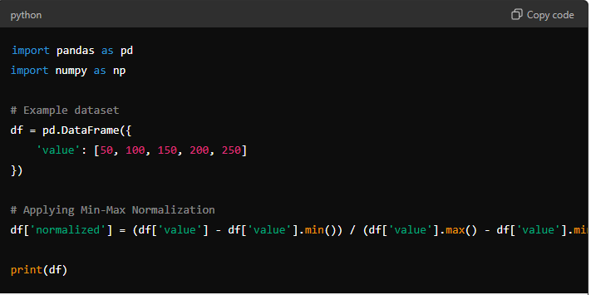

Slide 6
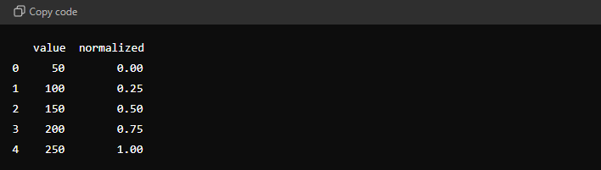
OUTPUT:

Slide 7
Applications of Normalization:
Preprocessing for Machine Learning: Many machine learning algorithms, like k-nearest neighbors, neural networks, and support vector machines, benefit from normalized data as it improves performance and convergence.
Data Visualization: Normalized data is easier to visualize, especially when comparing multiple features with different scales.

Slide 8
2. Standardization (Z-Score Scaling)
Standardization, also known as Z-score scaling, is a data transformation technique that adjusts the features of your data so that they have a mean of 0 and a standard deviation of 1. This technique is especially useful when your data has different units or scales, as it centers the data and scales it in a way that makes it easier to compare and analyze.

Slide 9
Why Use Standardization?
Comparability: Ensures that features with different units or scales are on a level playing field.
Model Performance: Improves the performance of machine learning models, particularly those that are sensitive to the scale of input data, like linear regression, logistic regression, and SVMs.
Interpretability: Makes it easier to interpret the coefficients in models, as all features will be on the same scale.

Slide 10
How Z-Score Scaling Works
The Z-score of a data point indicates how many standard deviations that point is from the mean of the data. The formula for Z-score scaling is:
Z = X−μ​
σ
Where:
X is the original value.
μ is the mean of the data.
σ is the standard deviation of the data.

Slide 11
Standardization (Z-Score Scaling)
What it does: Adjusts data so it has a mean of 0 and a standard deviation of 1.
Example:
Original data: [10, 20, 30]
Standardized data: [-1.22, 0, 1.22] (approx)

Slide 12
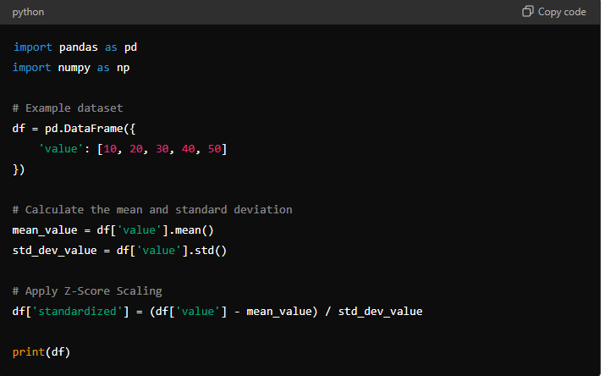

Slide 13
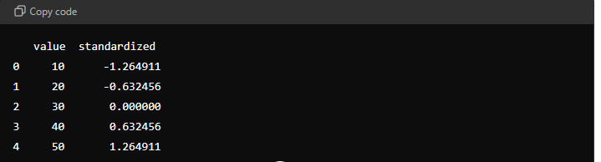
OUTPUT:

Slide 14
Applications of Standardization:
Machine Learning: Used in algorithms like k-nearest neighbors, principal component analysis (PCA), and linear regression to improve performance.
Statistical Analysis: Z-scores are commonly used in statistics to understand how far a data point is from the mean relative to the standard deviation.

Slide 15
Encoding
Encoding is a data transformation technique used to convert categorical data into a numerical format that can be used by machine learning models. Since most machine learning algorithms require numerical input, encoding is crucial for preparing categorical features for analysis.

Slide 16
Why Use Encoding?
Model Compatibility: Most machine learning algorithms require numerical input, so categorical data must be converted.
Improved Performance: Proper encoding can lead to better model performance by accurately representing categorical information.
Avoids Misinterpretation: One-hot encoding avoids the problem of giving ordinal significance to categories, which might mislead the model.

Slide 17
Types of Encoding
Label Encoding:
Converts each category in a feature to a unique integer.
Useful when the categorical data has an inherent order (ordinal data).
One-Hot Encoding:
Converts each category into a new binary column (0 or 1).
Useful when there is no ordinal relationship between categories (nominal data).
Prevents the model from assuming a natural order between categories.

Slide 18
Encoding:
Encoding transforms categorical data into numerical format.
One-Hot Encoding
What it does: Creates binary columns for each category.
Example:
Original data: ["Red", "Green", "Blue"]
One-hot encoded data: [[1, 0, 0], [0, 1, 0], [0, 0, 1]]

Slide 19
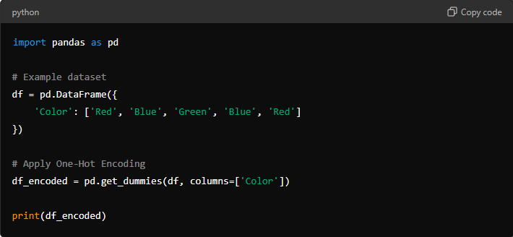

Slide 20
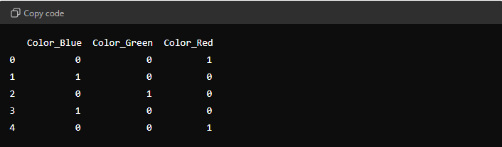
OUTPUT:

Slide 21
Label Encoding
What it does: Assigns a unique number to each category.
Example:
Original data: ["Red", "Green", "Blue"]
Label encoded data: [0, 1, 2]

Slide 22
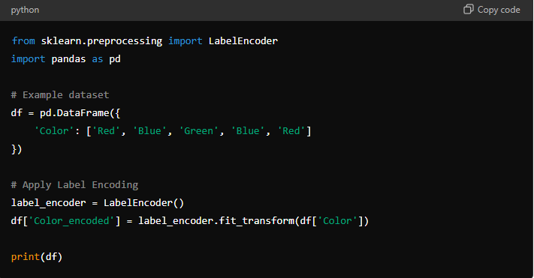

Slide 23
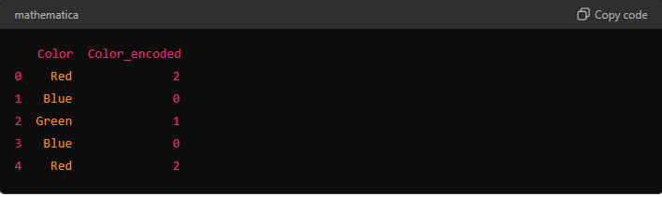
OUTPUT:

Slide 24
When to Use Which Encoding?
Label Encoding: Best suited for ordinal data where the categories have a meaningful order (e.g., "low", "medium", "high").
One-Hot Encoding: Preferred for nominal data where the categories do not have any intrinsic order (e.g., "cat", "dog", "bird").

Slide 25
Reshaping Data
Reshaping data is a crucial technique in data wrangling, especially when dealing with datasets that need to be reorganized for analysis or visualization. Pivot tables are one of the most powerful tools for reshaping data, allowing you to summarize and aggregate data across multiple dimensions.

Slide 26
What is a Pivot Table
A pivot table is a data processing tool used to summarize, aggregate, and reorganize data in a table format. It allows you to:
Change the structure of data from rows to columns (or vice versa).
Aggregate data using functions like sum, mean, or count.
Facilitate easy comparisons between different categories or groups.

Slide 27
Key Terms:
Long Format: Each row represents an observation, and there may be multiple rows for each group or category.
Wide Format: Each group/category is represented in a single row, with multiple columns representing the values of different observations.

Slide 28
Reshaping Data
Reshaping changes the structure of your data for easier analysis.
Pivot Tables
What it does: Summarizes data by key values.
Example:
Original data:
Date | Category | Value
2021-01 | A | 10
2021-01 | B | 20
2021-02 | A | 30
2021-02 | B | 40

Slide 29
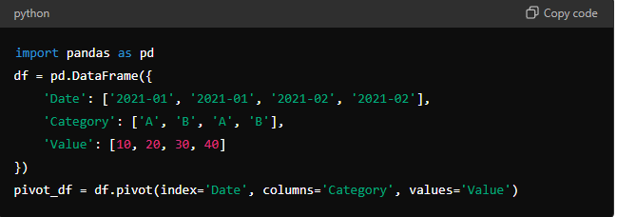
Pivot table:
Date | A | B
2021-01 | 10 | 20
2021-02 | 30 | 40

Slide 30
Stack
What it does: Converts columns into rows.
Example:
Original data:
Stacked data:
Date | A | B
2021-01 | 10 | 20
2021-02 | 30 | 40
Date | Category | Value
2021-01 | A | 10
2021-01 | B | 20
2021-02 | A | 30
2021-02 | B | 40

Slide 31


Slide 32
Unstack
What it does: Converts rows back into columns, reversing the stack operation.
Example:
Stacked data:
Date | Category | Value
2021-01 | A | 10
2021-01 | B | 20
2021-02 | A | 30
2021-02 | B | 40

Slide 33

Un stacked :
Date | A | B
2021-01 | 10 | 20
2021-02 | 30 | 40
These techniques help to prepare and organize data for analysis, making it easier to work with.

Slide 34
Extracting Features from Text
Extracting features from text is like picking out important parts of a sentence or a document that can help a computer understand and analyze the text. These "features" are pieces of information that tell the computer what the text is about or how it's structured.

Slide 35
Example Sentence:
"The quick brown fox jumps over the lazy dog.“
How We Extract Features:
Counting Words (Bag of Words):
What You Do: Count how often each word appears.
Example: The words in the sentence are "The," "quick," "brown," "fox," "jumps," "over," "lazy," and "dog." Each word appears once.
Feature: Word counts: {“The”: 1, “quick”: 1, “brown”: 1, “fox”: 1, “jumps”: 1, “over”: 1, “lazy”: 1, “dog”: 1}

Slide 36
Finding Important Words (TF-IDF):
What You Do: Check how common or rare each word is in many texts, and give more importance to rare words.
Example: If “fox” is rare in other texts but appears here, it’s more important.
Feature: Words like "fox" might get a higher score because they’re not common in most texts.

Slide 37
Understanding Word Meanings (Word Embeddings):
What You Do: Group words that have similar meanings.
Example: If another sentence had "fast brown fox," the words "quick" and "fast" would be recognized as similar.
Feature: The word "quick" might be grouped with "fast" because they have similar meanings.

Slide 38
Looking at Word Pairs (N-grams):
What You Do: Look at pairs or groups of words that appear together.
Example: "quick brown" and "lazy dog" are two-word pairs.
Feature: Pairs like “quick brown” and “lazy dog” help capture how words are used together.

Slide 39
Tagging Parts of Speech (POS Tagging):
What You Do: Identify the role of each word in the sentence (like noun, verb, adjective).
Example: “The” is a determiner, “fox” is a noun, “jumps” is a verb.
Feature: Tags: {“The”: determiner, “quick”: adjective, “fox”: noun, “jumps”: verb, “over”: preposition, “lazy”: adjective, “dog”: noun}

Slide 40
Finding Names and Dates (Named Entity Recognition):
What You Do: Identify specific things like names of people, places, or dates.
Example: If the sentence had “John” instead of “fox,” it would recognize “John” as a person’s name.
Feature: If “John” were in the text, it would be tagged as a person.

Slide 41
Understanding Feelings (Sentiment Analysis):
What You Do: Determine if the text is positive, negative, or neutral.
Example: If the sentence was “The fox happily jumps,” it might be seen as positive.
Feature: Sentiment might be neutral because there’s no strong emotion in the sentence.

Slide 42
Identifying Main Topics (Topic Modeling):
What You Do: Find out what the text is mainly about.
Example: If there were many sentences about animals, the topic might be "animals."
Feature: The topic could be “animals” based on words like “fox” and “dog.”
Summary:
When we extract features from the sentence "The quick brown fox jumps over the lazy dog," we’re picking out details like word counts, the roles of words, word pairs, and overall topics. These details help the computer understand and analyze the text, just like how you might take notes to remember important parts of a story.

Slide 43
Extracting features from categorical data
Extracting features from categorical data involves turning categories or labels into a form that can be used for analysis or machine learning. Categorical data consists of distinct groups or categories, such as colors, types of animals, or product names.

Slide 44
Example:
Suppose you have data about different types of fruits:
Fruit | Color | Type
Apple | Red | Fruit
Banana | Yellow | Fruit
Carrot | Orange | Vegetable
Spinach | Green | Vegetable

Slide 45
How to Extract Features from Categorical Data:
One-Hot Encoding:
What It Is: Create a new column for each category and mark the presence of each category with a 1 or 0.
Example: For the "Fruit" column, you create new columns for each type (Apple, Banana, Carrot, Spinach). Each row will have a 1 in the column corresponding to its fruit and 0s elsewhere.

Slide 46
Result:
Apple | Banana | Carrot | Spinach
1 | 0 | 0 | 0
0 | 1 | 0 | 0
0 | 0 | 1 | 0
0 | 0 | 0 | 1

Slide 47
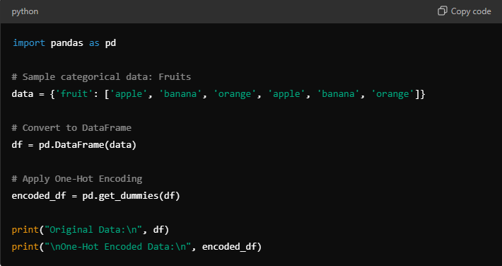

Slide 48
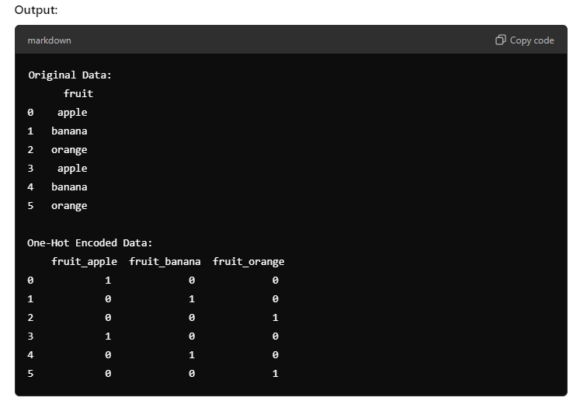

Slide 49
Label Encoding:
What It Is: Assign each category a unique number.
Example: Assign numbers to colors: Red = 1, Yellow = 2, Orange = 3, Green = 4.
Result:
Fruit | Color | Label Encoded
Apple | Red | 1
Banana | Yellow | 2
Carrot | Orange | 3
Spinach | Green | 4

Slide 50
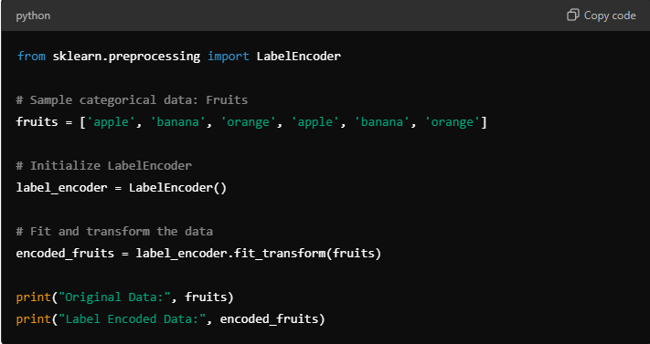

Slide 51
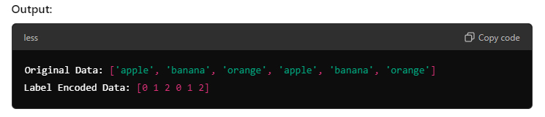

Slide 52
Summary
Label Encoding gives each category a unique number. It's simple but doesn't imply any relationship between categories.
One-Hot Encoding represents each category as a binary vector with a 1 for the category present and 0s for others. It’s more detailed and works well when there’s no inherent order among the categories.
Using these methods, we transform categorical data (like fruit names) into numerical features that machine learning models can use.

